Slide 1
VULNERABILITIES REPORT

Slide 2
DOMAIN:- https://vulnweb.com/
SUBDOMAIN:- http://testasp.vulnweb.com/

Slide 3
Title :-
SQL injection in your website.
Summary:-
Your website http://testasp.vulnweb.com/ has an endpoint that is
vulnerable to an injection namely – SQL(structured query language)
injection vulnerability , in which malicious SQL statements are inserted
into an input field(Username and password) for execution (e.g. to dump
the database contents to the attacker). For example, when user input
incorrectly filtered for string literal escape characters embedded in SQL
statements is not strongly typed and unexpectedly executed.

Slide 4
Steps to reproduce:-
To reproduce this attack,
1)An attacker will setup his kali terminal and install any vulnerability scanning tool for example :-xray , nmap, nessus, nulcei etc
2) He will gather information such as main website’s subdomains, open ports and many vulnerabilities present in your website.
3)Also, attacker will intercept the request using burp suit.
4)Navigate the login page and input the (‘ or 1=1--) payload in the username field with any password .5) Submit the form and bypass authentication

Slide 5
Environment:-
Platform :- Virtual box(kali-linux-2023.4)
Operating system:-Desbian
Browser:-Firefox
Severity:-
This vulnerability allows an attacker to bypass authentication and gain unauthorized access to sensitive data .The severity is classified as critical.
Recommendation:-
I recommend implementing prepared statements or parameterized queries in the login form.

Slide 6
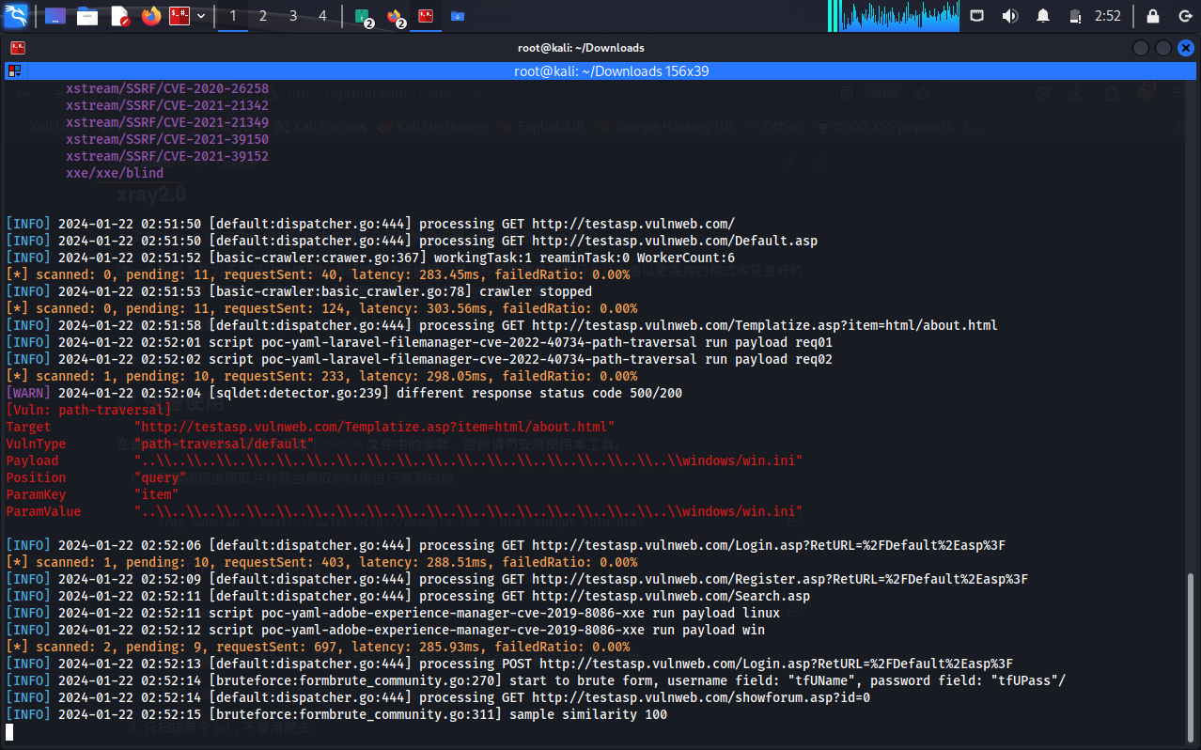
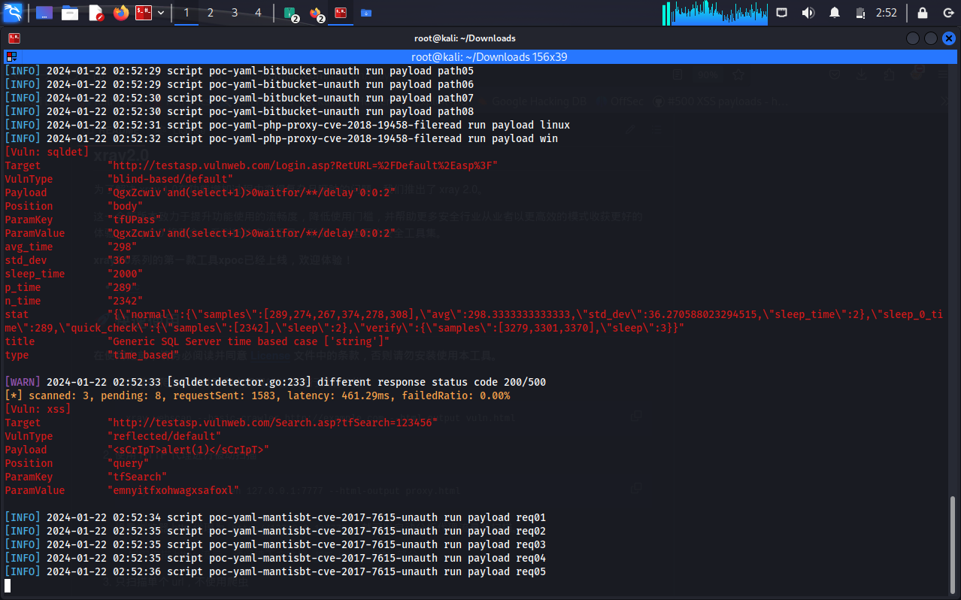
Attachments:-
Scanning vulnerabilities with help of tool Xray.

Slide 7
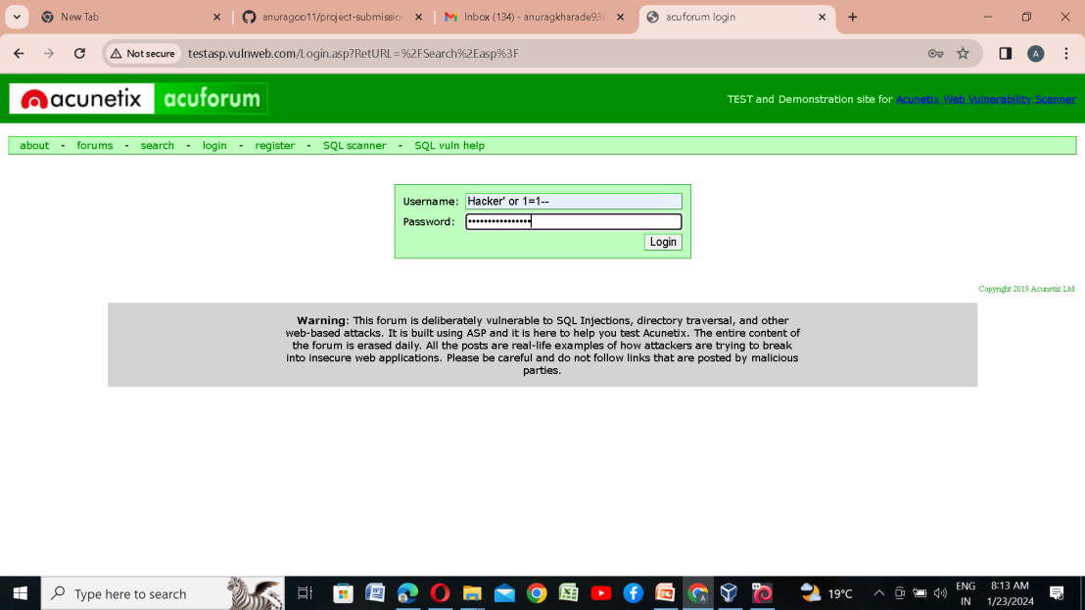
Attachments:-
Login authentication bypass using payload “ ‘ or 1=1-”.

Slide 8
Impact:-
Attackers can gain unauthorized access to the database by injecting malicious SQL
queries . Attackers can modify or delete existing database, potentially causing data
integrity issues or making unauthorized changes to user account. Organization may
face regulatory consequences if they fail to protect sensitive information.
Contact information:-
arabiannightmare93@gmail.com
Timeline:-
Discovery date :-January 22,2024
Planned public disclosure date:-February 1,2024

